Slide 1

“DISEASE PREDICTION AND MEDICAL CHECK-UP USING DEEP LEARNING”
PRESENTED BY
1. STUDENT NAME (REG.NO)
2. STUDENT NAME (REG.NO)
3. STUDENT NAME (REG.NO)
SUPERVISED BY
Dr./Mr./Ms. FACULTY NAME

Slide 2
INTRODUCTION
Early diseases prediction plays an important role in improving healthcare quality and can help individuals avoid dangerous health situations before it is too late.The deep learning field has shown greater potential in applications such as disease prediction and drug response prediction.Deep learning techniques have continuously improved the accuracy of medical disease prediction as well as helped shape overall healthcare.Input is obtained in the form of numeric values for diseases such as cancer, diabetes, and cardiovascular conditions. To predict diseases such as Pneumonia, malaria, or kidney diseases, an image is used as an input.Output results are acquired instantly in real-time in the form of a probable disease, its causes, and the aftermath.We will be using Deep Learning algorithms, mainly CNN and DNN, and Image Processing.

Slide 3
Literature survey
S.NO | TITLE | AUTHORS | DESCRIPTION
1. | A comparison of deep learning performance against health-care professionals in detecting diseases from medical imaging | Liva Faes Xiaoxuan Liu Pearse A Kean | Diagnosis of disease using deep learning algorithms holds enormous potential. The accuracy of deep learning algorithms is equivalent to health-care professionals, while acknowledging that more studies considering the integration of such algorithms in real-world settings are needed. The more important finding around methodology and reporting means the credibility and path to impact of such diagnostic algorithms might be undermined by an excessive claim from a poorly designed or inadequately reported study. In this review, we have highlighted key issues of design and reporting that investigators should consider.

Slide 4
PROBLEM STATEMENT
Health is one of the important part in human life and even though there are many disease prediction systems, none of them having multiple disease prediction system implementation and thus our proposed system will help lot of people

Slide 5
DEVELOPMENT ENVIRONMENT
HARDWARE REQUIREMENTS
Processor : Pentium Dual Core 2.00GHZ
Hard disk : 120 GB
RAM : 2GB (minimum)
Keyboard : 110 keys enhanced
SOFTWARE REQUIREMENTS
Operating system : Windows7 (with service pack 1), 8, 8.1,10
IDE : Anaconda
Language : Python

Slide 6
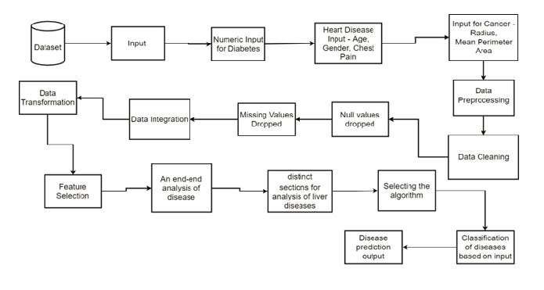
System architecture

Slide 7
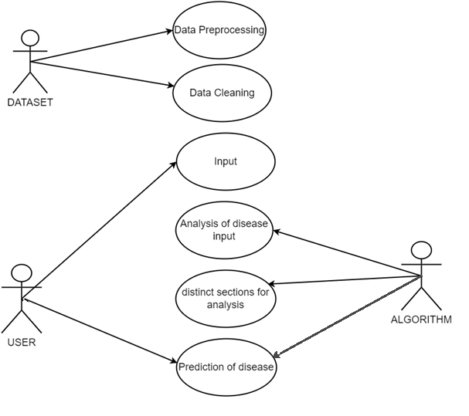
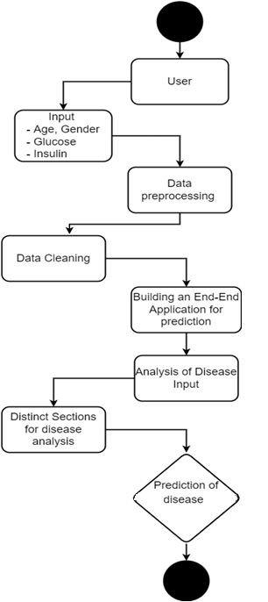
System Design
Use-Case Diagram Activity Diagram

Slide 8
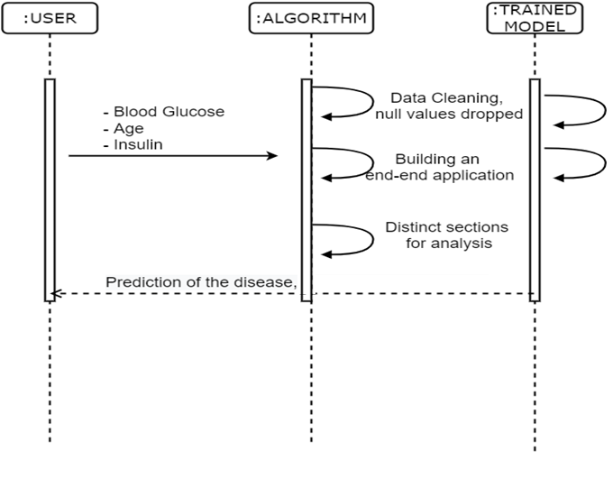
System Design
Sequence Diagram

Slide 9
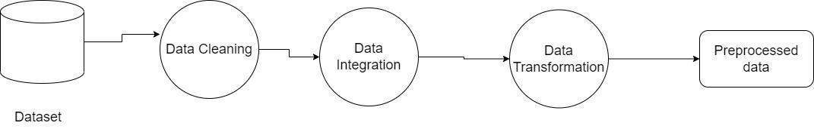
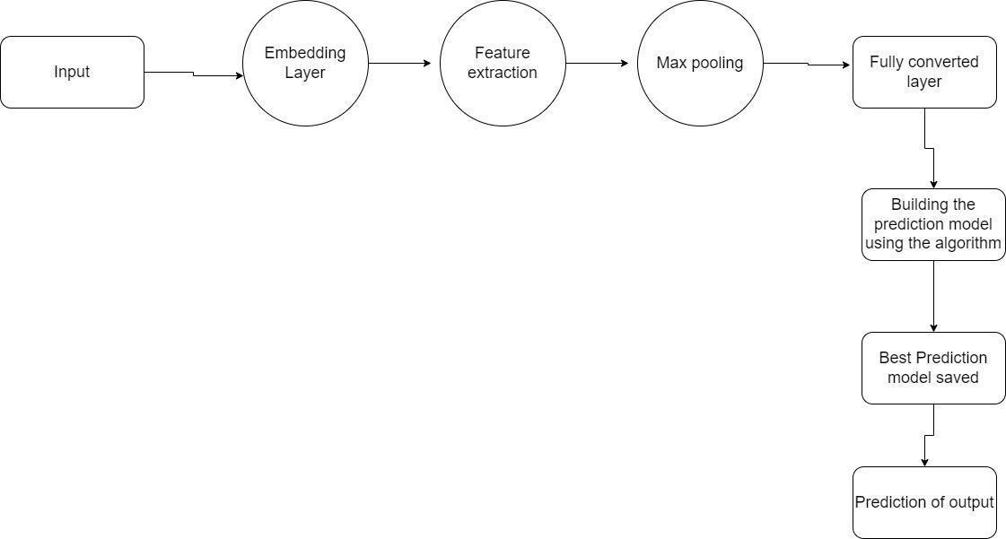
System Design
Data Flow Diagram 0
Data Flow Diagram 1

Slide 10
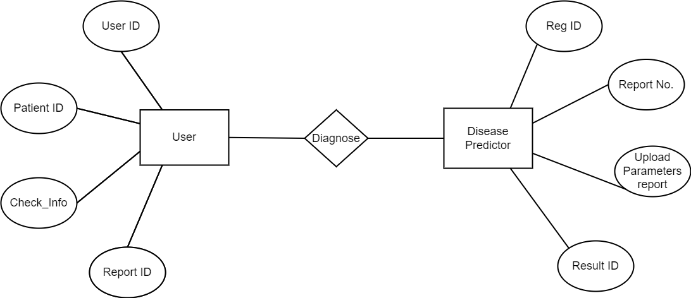
System Design
ER Diagram

Slide 11
Module Explanation
Getting the Input
Cancer, Diabetes Heart Disease Prediction
CNN for Image Classification
Logistic Regression for Numeric Input
End to End Diagnosis

Slide 12
Getting the Input
Initially, the disease dataset is taken as an input for the system for Diabetes, heart disease, and cancer datasets. Relevant elements are fed to the neural network by eliminating the irrelevant features using feature selection. The input is given to the network which performs some operations to generate the output. Inputs for various diseases are given as below –
Prediction of cancer disease via perimeters such as radius mean perimeter area
Prediction of Diabetes via blood glucose, thickness (numeric values)
Prediction of Heart disease via - chest pain type, age, gender (numeric)
To predict Malaria and Pneumonia we get the Image as input.
Prediction of liver diseases - Input
Age
Gender
Alkalinity
Phosphate balance

Slide 13
Getting the Input
Prediction of Kidney Diseases - Input
Input is obtained by fetching machine-oriented data from the dataset that is used to analyze the condition of the kidneys.
Prediction of Pneumonia – Input
Image is used as an input, image processing is leveraged.
Prediction of Malaria – Input
Image is used as an input, image processing is leveraged.

Slide 14
Cancer, Diabetes Heart Disease Prediction
The diagnosis of heart disease depends on the detailed and precise analysis of the patient's clinical test data and an individual's health history.
Here, we’re using the Deep Neural Network, DNN algorithm to diagnose heart diseases, diabetes, and cancer-related ailments.
The DNN with multiple hidden layers is used hence the proposed model has high performance than ANN.
Input for Diabetes(Numeric Values)
Glucose: the concentration test in glucose
Skin thickness: the thickness of the skin in the triceps fold (mm)
Insulin: insulin serum for 2-h (mu U/ml)
Input for Heart Diseases
Age: current age of the patient
Gender
Chest Pain Type
Input For Cancer-related Ailments
Radius
Mean Perimeter Area

Slide 15
CNN for Image Classification
In deep learning, a convolutional neural network (CNN) is a class of deep neural networks, most commonly applied to analyze visual imagery. It is a type of artificial neural network used primarily for image recognition and processing, due to its ability to recognize patterns in images. While CNNs are designed to solve problems with visual imagery, they also have many applications outside of image recognition and analysis, including image classification, natural language processing, drug discovery, and health risk assessments. CNNs also help provide depth estimation for self-driving cars. A CNN is a powerful tool but requires millions of labeled data points for training. Convolutional neural networks are composed of multiple layers of artificial neurons. Artificial neurons, a rough imitation of their biological counterparts, are mathematical functions that calculate the weighted sum of multiple inputs and output an activation value.

Slide 16
Logistic Regression for Numeric Input
Logistic regression is an algorithm used to predict the probability of categorical dependent variables. The dataset imported will be divided into two parts, namely training data and testing data. Training data is used as a basis for building models. This type of analysis is used to understand the relationship between the dependent variable and one or more independent variables by estimating probabilities using a logistic regression equation. In this way, you can predict how likely it is that an event will happen or a choice will be made. In order to predict the output of a categorical dependent variable, logistic regression must first determine the category or class of the dependent variable. This can be accomplished through a simple calculation, which returns an estimate of how likely it is that any given value within that category(s) will occur. The probabilistic values returned by this equation are then used to generate a prediction for how different combinations of independent variables would produce this particular output. Meanwhile, testing data is used as a basis for testing or validating the model. The data should contain different variables like age, gender, sex, chest pain, glucose levels, insulin levels, etc. In logistic regression, the dependent variable is always binary. Prediction using the logistic regression method will produce several data that can be used as a basis for concluding to make predictions. We have used a sigmoid function which helps in the graphical representation of the classified data. By using logistic regression, the accuracy is increased.

Slide 17
End to End Diagnosis
For the analysis of all these diseases, we will create an end-to-end application that is able to analyze all of the input data for the diseases, process the data using distinct techniques, and then accurately predict the most likely disease which is given as output. The application will contain distinct sections for analysis of liver diseases, cardiovascular diseases, kidney-related ailments, cancer, pneumonia, and malaria. Not only just the disease, but the application would also predict the most likely disease based on the given input data. The application will be designed to predict the disease, mention the aftermath of the same, how can it be treated and also the factors or changes that caused the disease. The application will act as a virtual assistant in major clinical laboratories, healthcare centers and medical clinics. The proposed model is a dynamic web application for an end to end disease prediction and diagnosis.
The application has been designed using the Flask interface that would effectively display the output and brief out the symptoms. The complete check-up would be performed using all the parameters and images as a data set. In future, with a little improvement, It would fetch data from the cloud and can be retrieved whenever needed.Our proposed methodology helps to improve the accuracy of diagnosis and is greatly helpful for further treatment. This work will be useful for identifying the patients who suffer from heart disease. When a patient is predicted with a positive result their reports and data can be closely analyzed.

Slide 18
TESTING
TEST NO. | INPUT | EXPECTED BEHAVIOUR | TESTING | STATUS
1 | User uploading proper input values | Data updated to the trained model | Unit Testing | Pass
2 | User uploading invalid input data | Data not updated to the trained model | Unit Testing | Fail
3 | User uploading proper image | Disease predicted | Output Testing | Pass
4 | User uploading invalid image | Disease prediction model not loaded | Output Testing | Fail

Slide 19
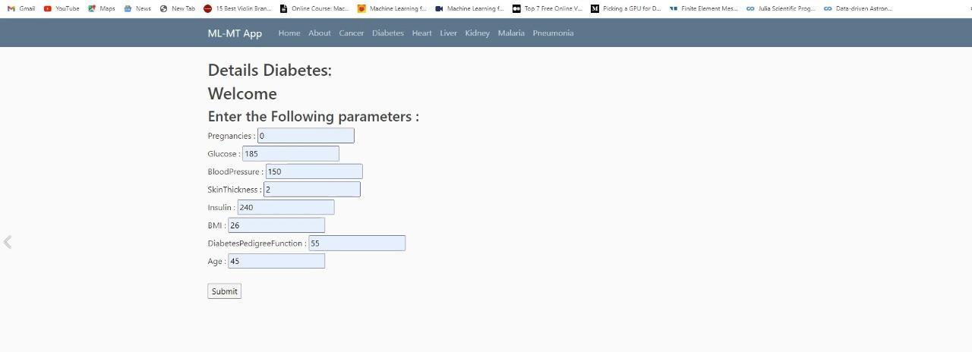
SCREENSHOTS
Diabetes – input

Slide 20
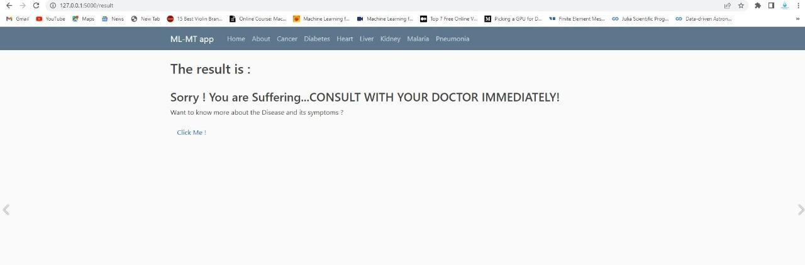
SCREENSHOTS
Disease predicted

Slide 21
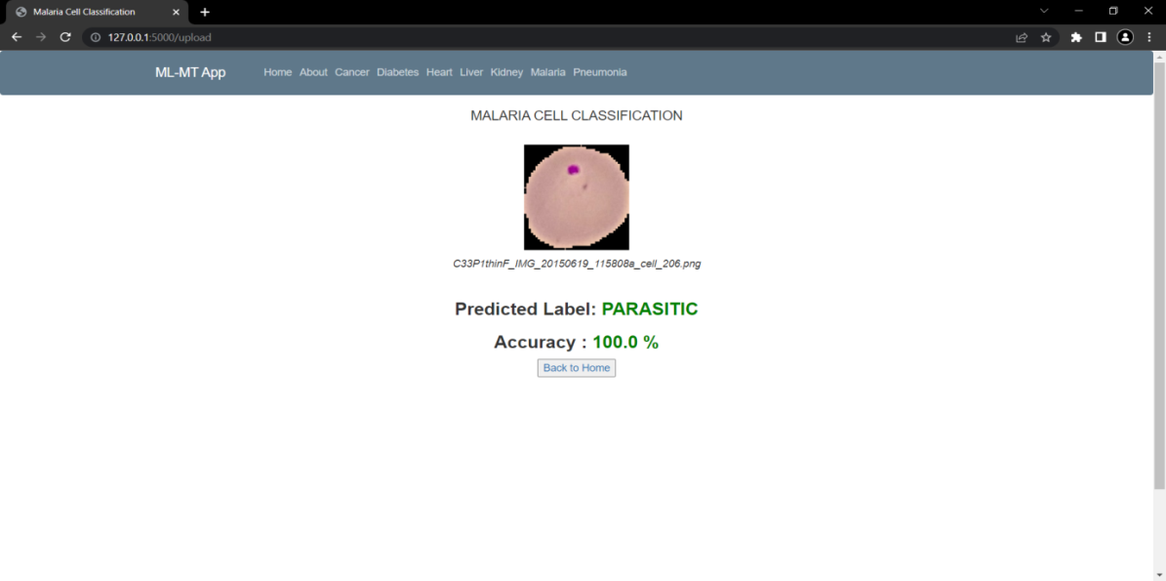
SCREENSHOTS
Parasitic malaria predicted

Slide 22
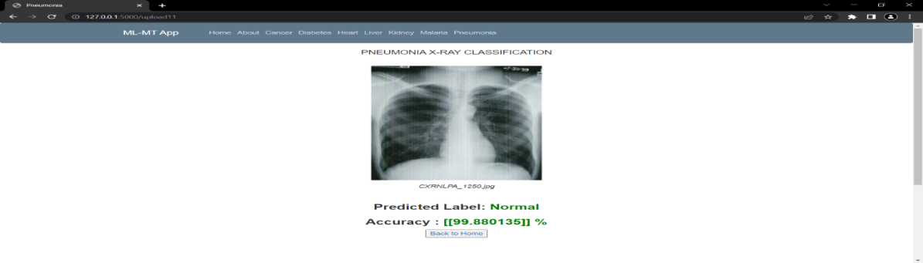
SCREENSHOTS
Normal lungs Predicted

Slide 23
CONCLUSION
The results thus justify the effectiveness of the proposed method in disease prediction.Although the results are promising, the datasets being used are relatively smaller in comparison to the big data culture predominant in the present day and age.Thus, the research’s future path will be to test the proposed model on large-high-quality datasets to check the effectiveness and reliability of the proposed model.Our proposed methodology helps to improve the accuracy of diagnosis and is greatly helpful for further treatment.This work will be useful for identifying the patients who suffer from heart disease. When a patient is predicted with a positive result their reports and data can be closely analyzed.In future enhancements, the accuracy has to be tested with different datasets and to apply other AI algorithms to check the accuracy estimation.

Slide 24
REFERENCES
[1] Liva Faes; Xiaoxuan Liu; Pearse A Kean, “A comparison of deep learning performance against health-care professionals in detecting diseases from medical imaging: a systematic review and meta-analysis”, The Lancet Digital Health, Volume 1, Issue 6, October 2019
[2] M. Chen, Y. Hao, K. Hwang, L. Wang and L. Wang, "Disease prediction by machine learning over big data from healthcare communities", IEEE Access, vol. 5, no. 1, pp. 8869-8879, 2017
[3] Puhpa Singh; Narendra Singh; Krishna Kant Singh; Akansha Singh,” Diagnosing of disease using machine learning”,
2021, Machine Learning and the Internet of Medical Things in Healthcare Pages 89-111, 2021
[4] Alexander Selvikvag; Lundervold; Arvid Lundervold; Katarzyna Węgrzyn-Wolska, “An overview of deep learning in medical imaging focusing on MRI”, Zeitschrift für Medizinische Physik, Volume 29, Issue 2, Pages 102-127, May 2019,
[5] Yuanyuan Pan; Minghuan Fu; Biao Cheng; Xuefei Tao; Jing Guo,“Enhanced Deep Learning Assisted Convolutional Neural Network for Heart Disease Prediction on the Internet of Medical Things Platform, IEEE Access ( Volume: 8), May 2020,
[6] hiraj Dahiwade; Gajanan Patle; Ektaa Meshram,”Designing Disease Prediction Model Using Machine Learning Approach”,2019 3rd International Conference on Computing Methodologies and Communication (ICCMC), 2019
[7] Durr-e-maknoon Nisar; Meshrif Alruily ; Sultan H. Al Motor; Rashid Amin,“Healthcare Techniques Through Deep Learning:Issues, Challenges and Opportunities”, 2019
[8] Jerome Thevenot; Miguel Bordallo Lopez; Abdenour Hadid,“A Survey On Computer Vision For AssistiveMedical Diagnosis From Faces”, IEEE JOURNAL OF BIOMEDICAL AND HEALTH INFORMATICS, VOL. 22, No. 5, 2018
[9) Rahatara Ferdousi; M. Anwar Hossain; Abdulmotaleb El Saddik, “Early-Stage Risk Prediction of Non-Communicable Disease Using Machine Learning in Health CPS”, IEEE Special Section On AI And IoT Convergence For Smart Health, July 2021
[10] Alice Othmania; Abdul Rahman Taleb; Hazem Abdelkawy; Abdenour Hadid, “Age estimation from faces using deep learning: a comparative analysis”, Computer Vision and Image Understanding, Volume 196, 102961, July 2020

Slide 25
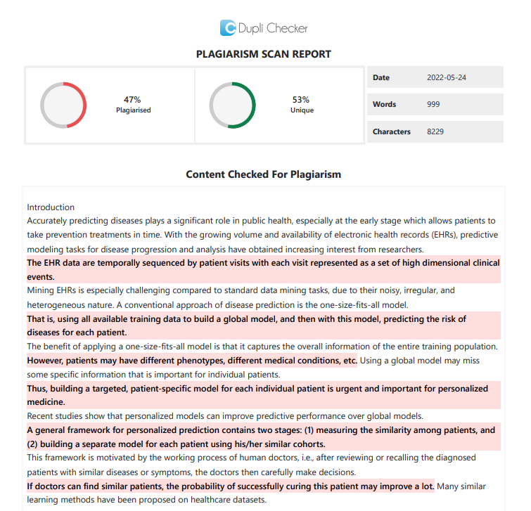
PLAGIARISM REPORT

